Slide 1
Spring Dependency Injection
Presented by: Jack Coy

Slide 2
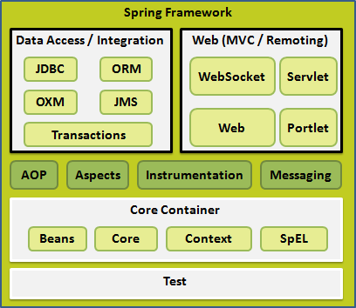

Slide 3
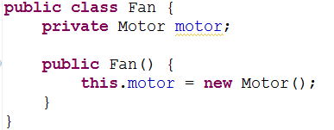
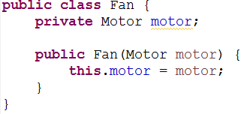
IoC – Inversion of Control
Want to remove control from the component
Dependencies are passed in or set, instead of instantiated by component
VS

Slide 4
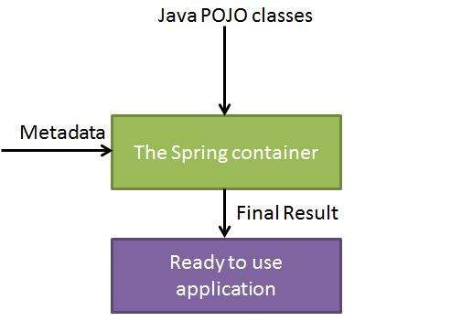
Spring Containers
Control is removed from your Java Components and moved to the container.
Manages full lifecycle of your Components

Slide 5
Two types of Spring Containers
Spring BeanFactory Container
Simple, basic support for Dependency Injection
Spring ApplicationContext Container
Includes all functionality of BeanFactory
Adds enterprise features
Use by default unless speed is a significant concern

Slide 6
Beans
“A bean is an object that is instantiated, assembled, and otherwise managed by a Spring IoC container. These beans are created with the configuration metadata that you supply to the container” http://www.tutorialspoint.com/spring/spring_bean_definition.htm
A configured bean can then be provided by an ApplicationContext
The ApplicationContext container will instantiate the bean component injecting the necessary dependencies according to your configuration.

Slide 7
Configuring your beans
Xml config file
Beans.xml
Used by a ClassPathXmlApplicationContext
Beans configuration class
Used by a AnnotationConfigApplicationContext

Slide 8
Bean - Scope
You can configure the “scope” of a bean.
Singleton
Bean is instantiated when the context is created and the same instance of the bean will be used whenever it is needed.
Prototype
A new Bean is instantiated every time it is needed or requested

Slide 9
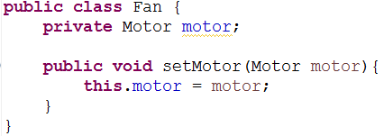
Two Types of Dependency Injection
Constructor-based
Setter-based

Slide 10
Injecting Collections
Lists – Standard List
Sets – List without duplicates
Maps – Standard Java map, any time allowed for key or value
Props – Primitive properties map where key and value are both strings

